Slide 1

The Cave – Rob Hodgson

Slide 2
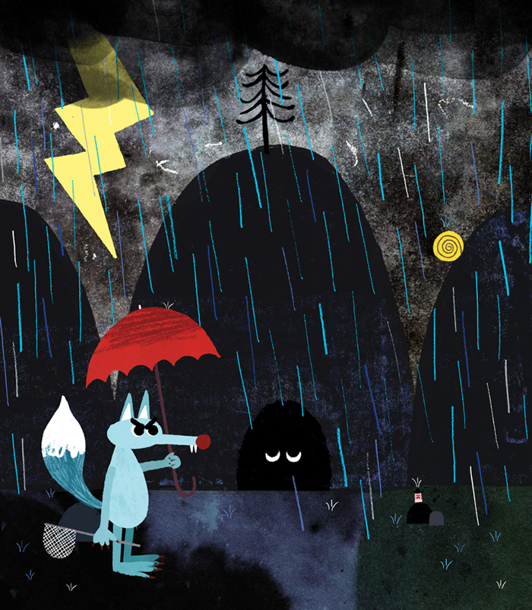
Watch the video of the story
https://www.youtube.com/watch?v=HtybT-gBcGU

Slide 3
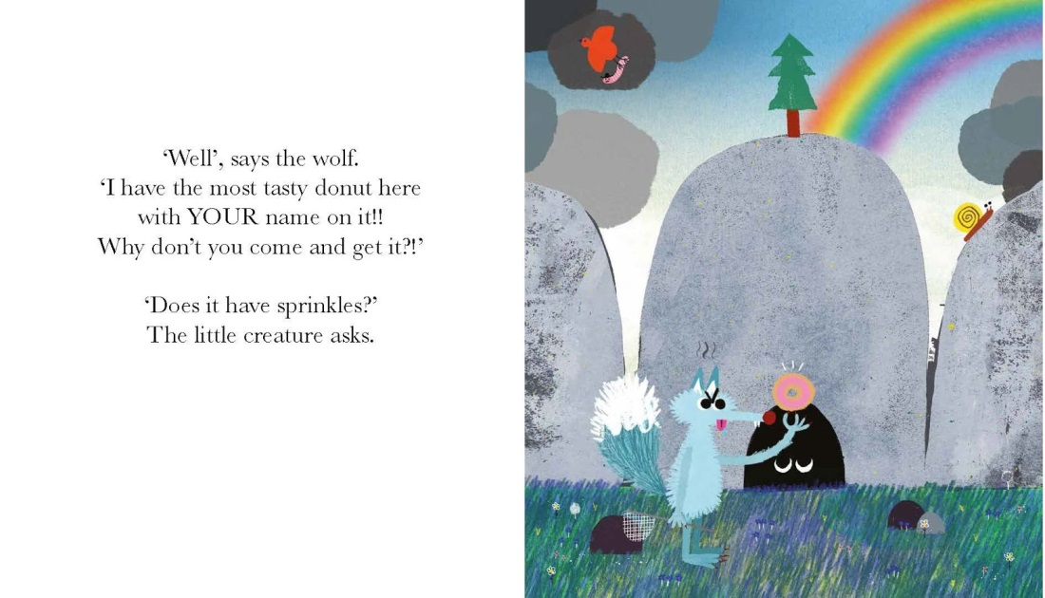
Can you read the key words from the story?
that
is
to
a
you
come
be
so
go
it
there

Slide 4
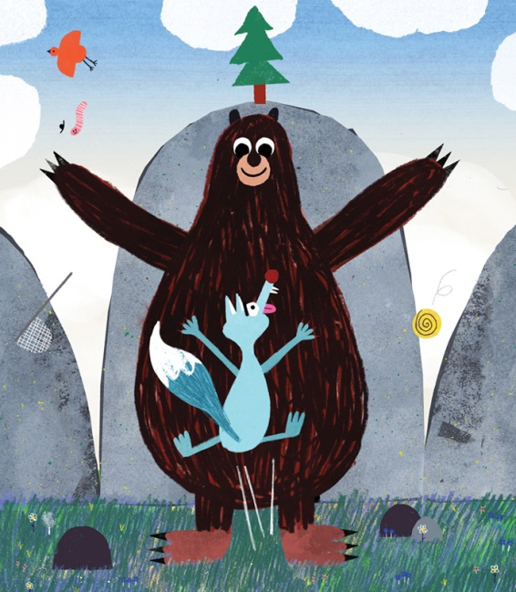
Inference Questions
How do you think the creature in the cave was feeling?
How do you know?

Slide 5
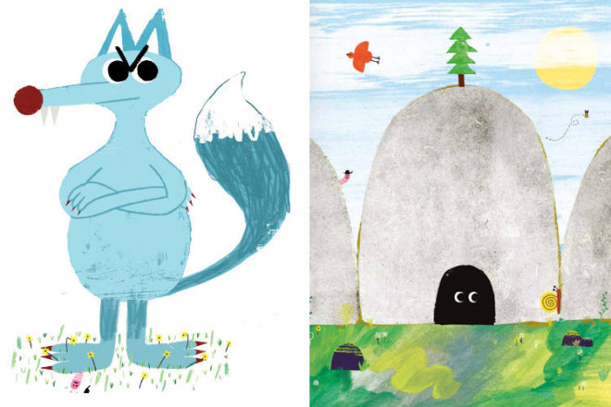
Prediction Question
What do think will happen now that the wolf is in the cave?

Slide 6
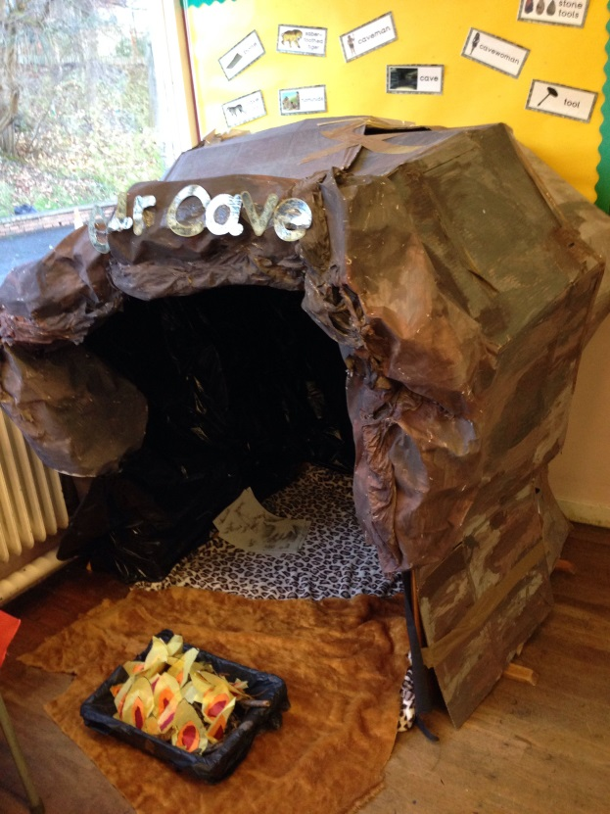
Activity 1
Make your own cave, under a table, using a clothes drier, in a cupboard or under the stairs.
Hide in your cave.
Collect all your teddy bears to sit in your cave.

Slide 7
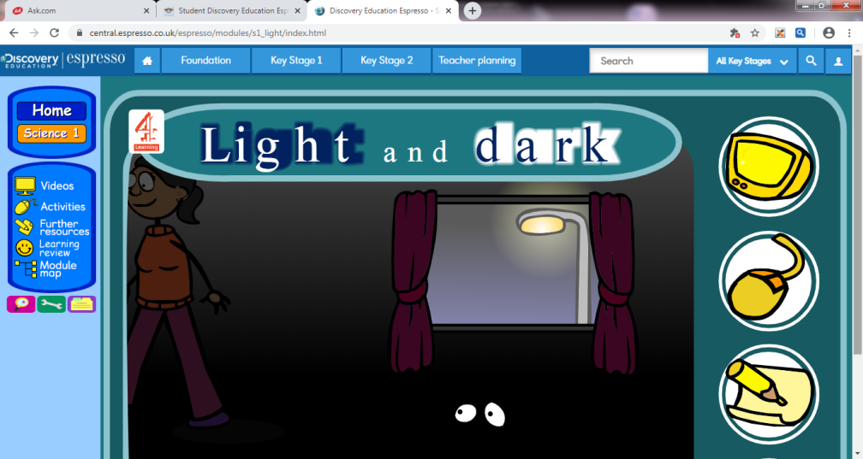
Activity 2
Try out some torches in your cave.
Log into espresso and learn more about light and dark
https://central.espresso.co.uk/espresso/modules/s1_light/index.html

Slide 8
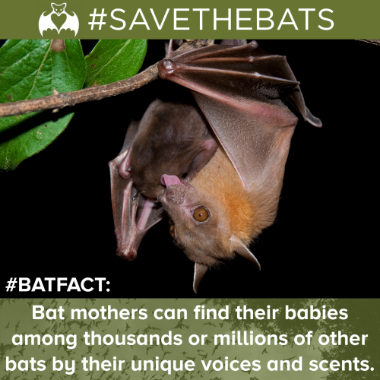

Activity 3
Make some paper bats for your cave. Recap your learning from earlier in the year. Write some bat facts in your writing book.

Slide 9
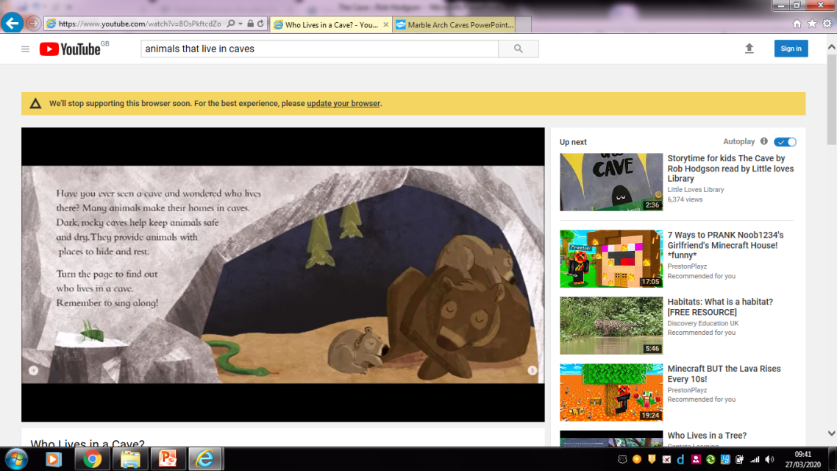
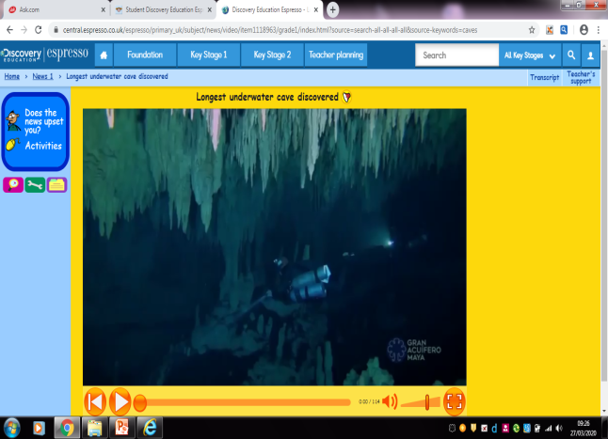
Activity 4
Learn more about caves. Write some facts in your writing book.
Make a list of other animals that live in caves.
Learn the song about animals that live in caves.
Check out these videos to help you.
https://www.youtube.com/watch?v=puA0YC-hSPM
https://www.youtube.com/watch?v=8OsPkftcdZo
https://central.espresso.co.uk/espresso/primary_uk/subject/news/video/item1118963/grade1/index.html?source=search-all-all-all-all&source-keywords=caves

Slide 10
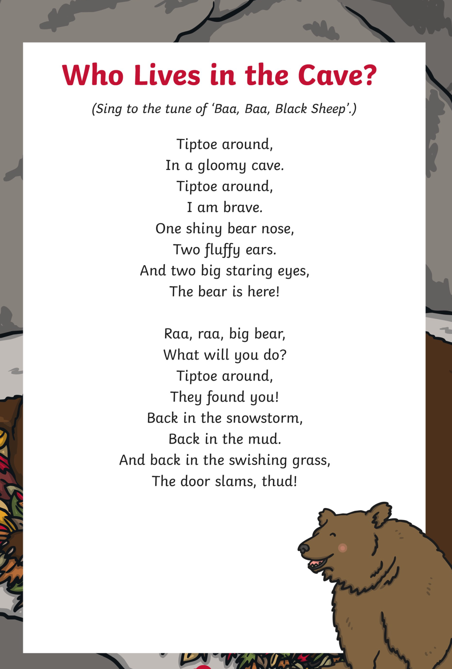

Slide 11
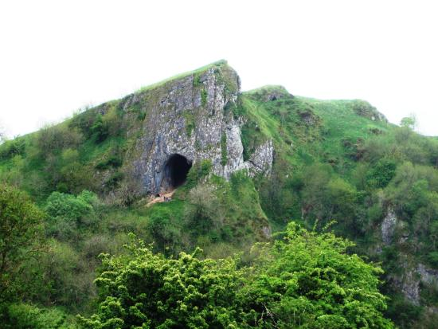
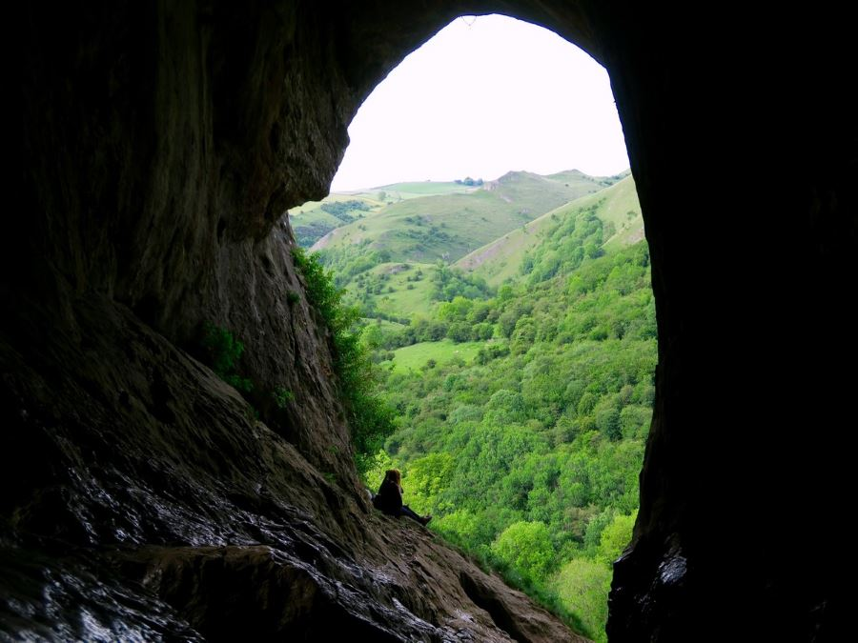
Activity 5
Find out about Thors cave in the Manifold Valley.
https://www.youtube.com/watch?v=9tHDnpeyuw4

